Slide 1
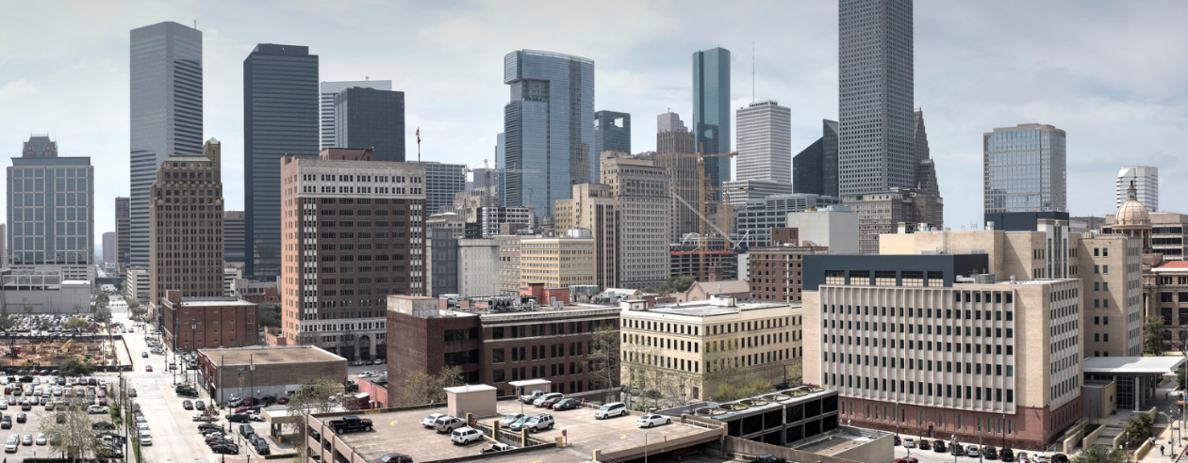
Crisis Management in Trial Courts
Strategies to Weather the Storm
Judge Margaret Harris
Harris County Criminal Court at Law No. 5
Ed Wells, Court Manager
Harris County Office of Court Management

Slide 2
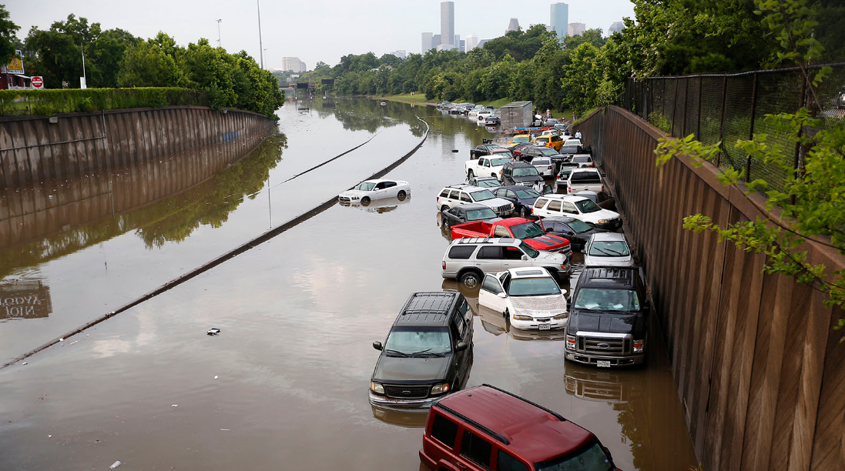
Notes:
Crisis’ come in all shapes and sizes. Some can be planned for, some cannot.

Slide 3
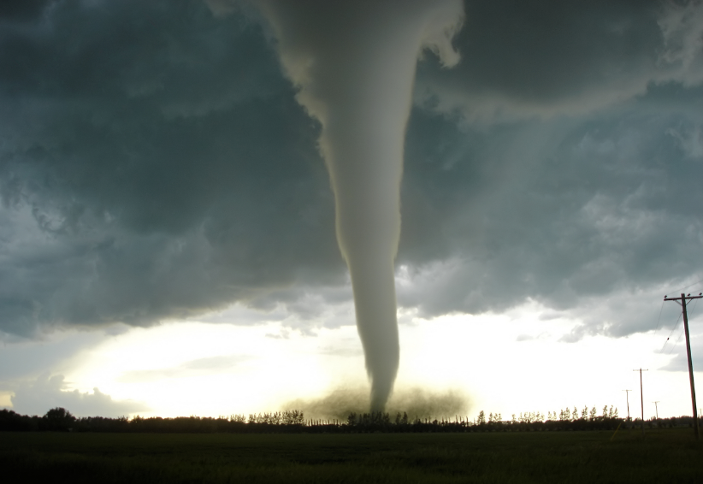

Slide 4
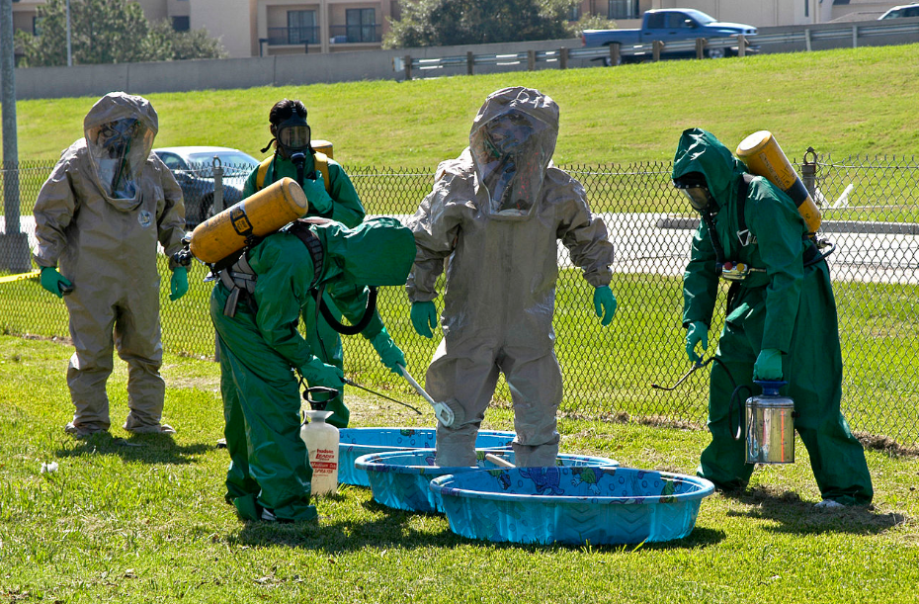

Slide 5
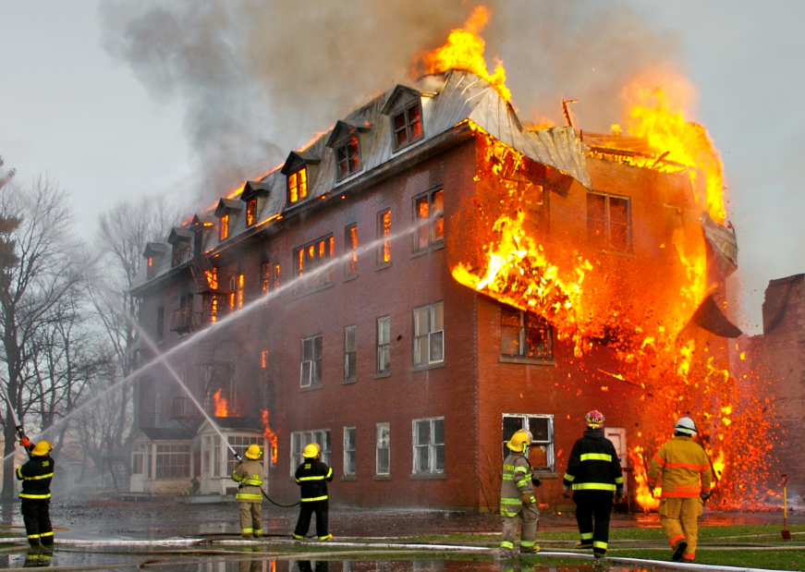

Slide 6
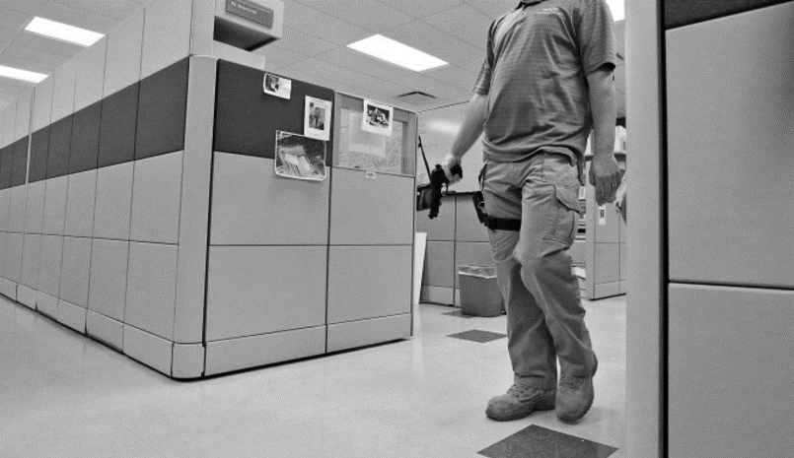

Slide 7
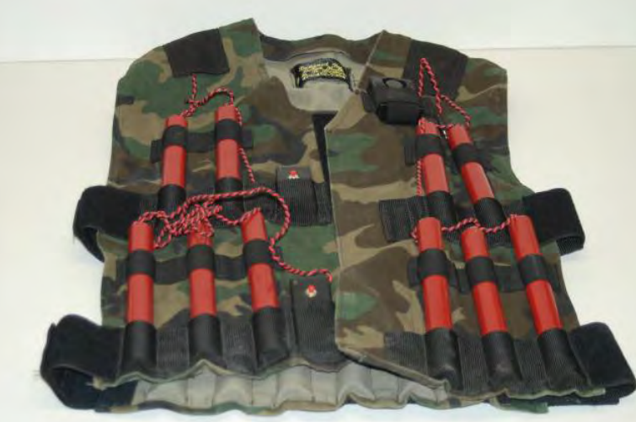

Slide 9
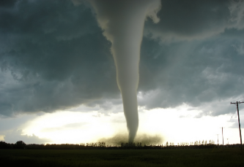
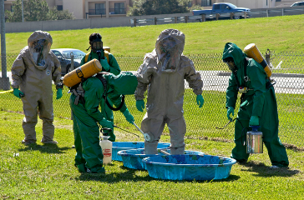
Notes:
A “crisis” doesn’t necessarily mean huge catastrophe – Continuity of Operations planning is “contingency” planning. Even for small events that cause a building or resources to be temporarily unavailable.
It is easy to fall into the trap of calling this “disaster” or “crisis” planning, but this is really “continuity” planning. While interruption is obviously a byproduct of a disaster or crisis, it can be a symptom of many things -
The KEY is to have a plan in place before you need to rely on one
Crisis Examples:
Tornado
Flood
Fire
Hurricane
Pandemic
Active shooter
Terrorism event
These are pretty extreme examples, but there are other unconventional crisis’:
Power outage
HVAC outage
Major unplanned building problem such as sewage or water malfunction
The unique challenges of a pandemic:
Staff availability
The safety of court staff
… public health emergency preparedness (PHEP) is the capability of the public health and health care systems, communities, and individuals, to prevent, protect against, quickly respond to, and recover from health emergencies, particularly those whose scale, timing, or unpredictability threatens to overwhelm routine capabilities.” (Christopher Nelson, Conceptualizing and Defining Public Health Emergency Preparedness) - 2007

Slide 10
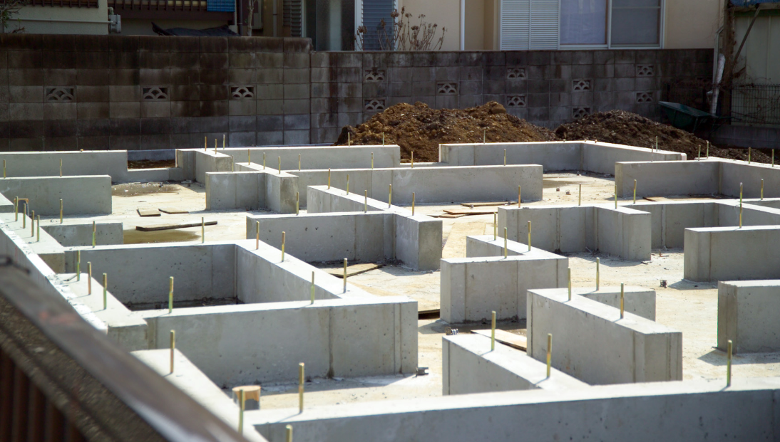
FOUNDATION

Slide 11
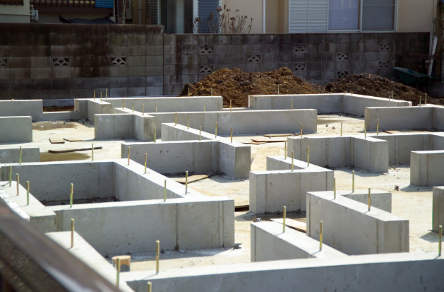
The Foundation
Leadership judge(s), judiciary
Court Manager & staff
Materials:
Continuity of Operations (COOP) guide
Contact lists
Assessment of Crisis
Notes:
Leadership judges, judiciary
Court Manager & Staff
Materials:
“Continuity of Operations Plan” = COOP – tell them what it is several times before referring to it as a “COOP”
The fundamental purpose of a COOP plan is to minimize a major event’s impact on access to justice
Contact lists
Assessment of crisis
A Continuity of Operations (COOP) plan can even be utilized in the event of a building renovation or major maintenance, or mechanical failure of HVAC systems
Court environments vary - financial resources, court locations, type of system (unified/independent) will be significantly different from state to state, county to county
Guides, best practices, etc. exist. We’re scratching the surface with this presentation and handout materials. But any amount of planning depends on a strong foundation of communication and leadership.
The need for TEAMWORK and ORGANIZATIONAL LEADERSHIP is CRUCIAL at every level of continuity planning.

Slide 12
SUPPORT STRUCTURE

Slide 13
Building the Support Structure
Prioritization of Services
Stakeholders in justice
Preparation is ongoing
Amount of time to operate without full capacity
Notes:
Prioritization of Services
Jail vs. Bond
Mental-health procedures
Providing access to emergency civil court orders
Jurisdictional size and facilities needs might require collaboration with and support from surrounding jurisdictions
Notify the public – litigants, jurors, citizens
Stakeholders in justice
Identifying, communication and cooperation in advance of a crisis
Preparation is ongoing
You may or may not have advanced warning
Ex. – an active shooter, a weather event, budget crisis
Amount of time to operate without full capacity

Slide 14
Courts
Funding Body
Constable(s)
Probation
Prosecutor
Defense Bar
Clerk of Court
Other Support Depts.
Pre-Trial Services
Public Defender
Sheriff
Other Law Enforcement
Notes:
The courts have a leadership responsibility in the justice environment.
Courts’ mission is the purposes and responsibilities of courts: DOING JUSTICE and ENSURING JUSTICE IS DONE
Stakeholders in justice
It is OUR responsibility to build this consensus & plan – it won’t be the prosecutor, Commissioners Court, Defense Bar, etc.

Slide 15
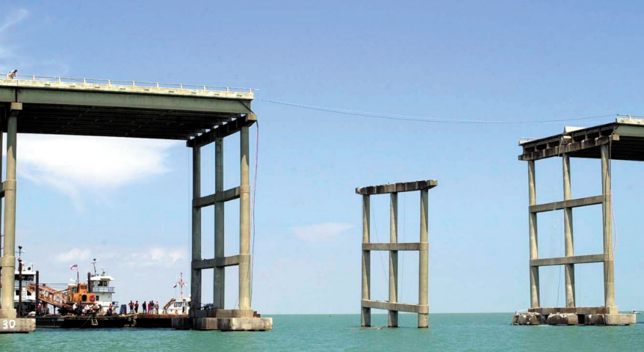
Continuity Planning is Relationship Building
Notes:
The courts provide the bridge to connect them

Slide 16
Consider Essential Steps and Services
Steps
Courts meet to identify essential services, alternatives, and partners
Form a committee of essential partners
Create a Continuity of Operations Plan (COOP)
Monitor and analyze potential threats
Execute the COOP
Services
Bond vs. jail
Mental-health procedures
Notes:
Steps
Build consensus within and around the organization
Create a Continuity of Operations Plan (COOP)
Monitor and analyze potential threats
Execute the COOP
As part of the COOP, establish an order of succession and communicate it to colleagues (team of leadership judges)
Services – these will be unique to individual jurisdictions and business processes:
Bond vs. jail
Mental-health procedures
Maintaining access to emergency civil court orders
Etc.
Jurisdictional size: might have to collaborate and team up with regional counties and municipalities

Slide 17
Consider Essential Steps and Services
Steps
Build consensus within and around the organization
Create a Continuity of Operations Plan (COOP)
Monitor and analyze potential threats
Execute the COOP
Notes:
Steps
Build consensus within and around the organization
Create a Continuity of Operations Plan (COOP)
Monitor and analyze potential threats
Execute the COOP
As part of the COOP, establish an order of succession and communicate it to colleagues (team of leadership judges)

Slide 18
Consider Essential Steps and Services
Steps
Build consensus within and around the organization
Create a Continuity of Operations Plan (COOP)
Monitor and analyze potential threats
Execute the COOP
Notes:
Steps
Build consensus within and around the organization
Create a Continuity of Operations Plan (COOP)
Monitor and analyze potential threats
Execute the COOP
As part of the COOP, establish an order of succession and communicate it to colleagues (team of leadership judges)

Slide 19
Communication
Notes:
Let’s Talk about Communication: You need to develop a communication strategy
*Consider transitioning discussion to the next slide, comparing communication yesteryear with today’s variety and challenges*
Create and maintain an emergency contact list. Get other departments and agencies to do the same. Store and distribute a master-list both on paper and electronically.
Create and maintain a detailed list of authority for decision-making
Create communications strategy for both internal (court staff) and external (public):
This is NOT something you want to have to figure out during an emergency, without having planned. There is probably a creative / witty way to illustrate this.
Website? Email listserv or distribution group? Facebook? Twitter?
Media strategy - press releases, etc.
Communication strategy/policy: During monitoring and pre-incident (if applicable)
Communication strategy/policy: Post-Incident and Recovery
Procedure for developing and authorizing the transmittal of a public notification
Who communicates with the public? Over what mediums? Social media?
Who communicates with the press? Who doesn't communicate with the press?
These things need to be discussed and established before they are necessary to use.
The courts are an institution and must strive to demonstrate stability to the greatest extent possible during a crisis. This is the importance of a unified message: the perception that the courts are in sync, collected, stable

Slide 20
Notes:
We need to consider all available communication options

Slide 21
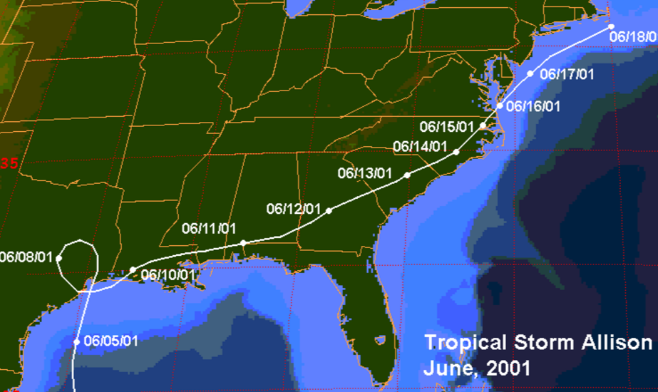
Notes:
First we’ll talk about one of the worst Houston / Harris County disasters to strike in decades: Tropical Storm Allison
Tropical Storm Allison statistics:
More than 70,000 homes were flooded, almost 3,000 of which were completely destroyed
3 people died in Houston, 23 in Texas
$9 billion in 2001, adjusted for inflation is over $12 billion today
Criminal Courthouse, which had opened less than 2 years prior, had to be evacuated and remained closed for more than a full year
The year was 2001 – challenges were different:
Land lines were ubiquitous. Now, many people don’t even have one.
VERY few cellphones; mainly pagers and land lines
Since then: added countless ways to communicate: cellphones, text messages, email, social media, alternative messaging platforms.
While beneficial in some ways, this also complicates communication in other ways. Need to plan around this.
Example: during a recent crisis (Memorial Day Flood 2015), Ed emailed Judge Harris, who copied/pasted SMS to the rest of the judges

Slide 22
Houston: Memorial Day Flood, 2015
Despite planning, improvisation is always necessary:
It was determined on the fly that the Sheriff’s Office would need to use another nearby facility for staging of female detainees
2 (out of 15) Criminal Court judges presided over dockets all day Wednesday, with a third judge at a different location with female detainees
Needs identified during the event:
A large staging area for defendants
A place for attorney consultation with defendants prior to arriving in the courtroom
These needs were added to the COOP during a review process after the event
Notes:
Needs identified during the event
These changes were made just in time for the tax day flood in 2016

Slide 23
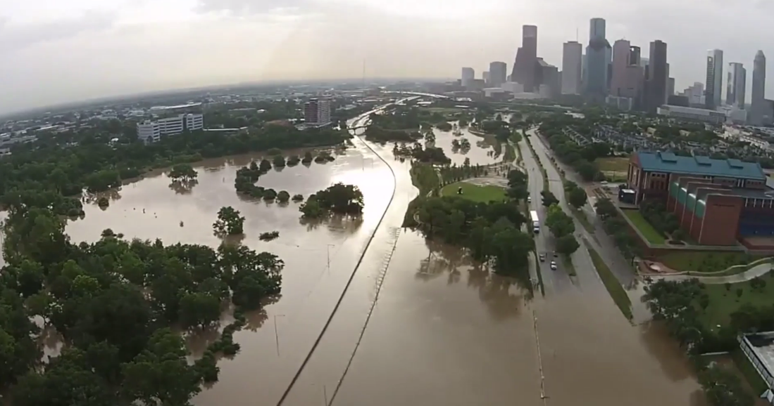
Houston, Texas Memorial Day Flood 2015
Source: Drone Footage by Bryan Rumbaugh (Houston) via Washington Post
Notes:
Storm Impact on Houston
Monday May 25th, 2015. Unpredictable - a storm rolled into Houston from the west, at about 8pm - by midnight it had dumped an incredible amount of water. By midnight, 911 was no longer able to respond to calls.
Tuesday morning, Houston woke up to disastrous flooding
A total of 3,015 homes were flooded
More than 3,500 multi-family units were flooded
8 people died in the storm
4th worst flood in Houston history in terms of homes flooded
Harris County Courts – Continuity of Operations
Memorial Day - Monday, May 25, 2015 - a massive rain storm arrived late during the night after a holiday, continued into Tuesday morning
Tuesday morning: the greater Houston area had sustained massive flooding and enormous damage
All Harris County Courthouses were closed on Tuesday - the Criminal Justice Center was closed to the public on Wednesday as well.
Per the Harris County Courts' Continuity of Operations Plan, 24/7 magistration continued uninterrupted, all bond cases were automatically reset, and we quickly organized a centralized jail docket for misdemeanor defendants, some of whom had already been in jail over a holiday weekend.
Also per the COOP, the Juvenile Justice Center building was a primary (first choice) DR physical location for this exact kind of scenario (one in which the CJC is inoperable)
Staging of jail detainees: it was determined on the fly, that the Sheriff's Office would need to use another nearby building, the Jury Assembly Plaza to stage female detainees
2 (of our 15 at the time) Criminal Court judges presided over dockets all day Wednesday, with a third judge at a different location (Jury Assembly Plaza) with female detainees
During the event we “learned” the need for a large staging area for defendants, and a place for defense counsel and defendant to consult (w/ and without ADA’s) before being sent to the courtroom. This need was later added to the COOP during a review process after the event.
Must have a variety of locations to move people to – both short term and longer term relocation plans if possible
High-Level Recap of COOP Situation
A COOP plan had already been established
Cross-departmental COOP roles had already been discussed
Cross-departmental contact list was up to date
Enormously beneficial: The DA, District Clerk, and courts had pre-staged equipment, forms, and key documents as part of COOP planning
Harris County was reasonably prepared, but there was still a need to improvise and leverage existing strategic partnerships – not only among other departments, but also the executive leadership team: presiding judge and court administrator

Slide 24
Houston: Memorial Day Flood, 2015
A few statistics from the event:
534 defendants were brought to the COOP court
279 of these cases were disposed
238 cases with attorney appointed on May 27
194 defendants from May 27 docket were released same-day
Thanks to the diligent collaboration between …
Notes:
To contrast Tropical Storm Allison in 2001, we’ll talk about our most recent unplanned disaster recovery operation: Memorial Day Flood (2015)
County Criminal Courts
Sheriff
District Attorney
District Clerk
Constable Pct. 1
Pre-Trial Services
Adult Probation (CSCD)
Public Defender’s Office
Court Appointed Defense Counsel
Facilities and Property Management – game changer: FPM made tunnels available for transporting detainees

Slide 25
“Leadership support starts at the top. For local courts, this means that the presiding or chief judge underscores the value and importance of emergency planning and encourages the involvement of all judges and court staff through written and oral communications and by committing staff and other resources to the planning process.”
- Steps for COOP Planning, NCSC & BJA
Notes:
Leadership Support Starts at the Top
“Leadership support starts at the top. For local courts, this means that the presiding or chief judge underscores the value and importance of emergency planning and encourages the involvement of all judges and court staff through written and oral communications and by committing staff and other resources to the planning process.”

Slide 26
Everything will be ok.
Notes:
Everything will be OK
When you’ve begun relationship building, and you have a COOP in progress or produced, everything will be OK.

