Slide 1
FOSTERING INNOVATION IN THE U.S. COURT SYSTEM
IDENTIFYING HIGH-PRIORITY TECHNOLOGY AND OTHER NEEDS FOR IMPROVING COURT OPERATIONS AND OUTCOMES
Rand Corporation, 2016
http://www.rand.org/pubs/research_reports/RR1255.html
Presented By Hon. Kirk Tabbey
Courts Advisory Panel Member

Slide 2
A product of a joint effort by RAND Corporation and RTI International to report on the results of the
COURTS ADVISORY PANEL
as a part of the National Law Enforcement and Corrections Technology Center (NLECTC) Priority Criminal Justice Needs Initiative
a component of the U.S. Department of Justice
National Law Institute (NIJ)
in partnership with the University of Denver,
Police Executive Research Forum,
RAND and RTI

Slide 3
FEDERAL AND STATE COURT CHALLENGES
High Caseloads
Resource Constraints
Facility Security
Information Sharing
Innovative Problem Solving Court Models
Racial and Economic disparities in Justice Process and Outcomes
Increasing Unrepresented Litigants

Slide 4
THESE CHALLENGES REQUIRE INNOVATION
Use of new technologies to manage and share data across all systems
Policy and Process changes for new approaches to address justice disparities and assist unrepresented litigants
Operational Practices that improve Security yet maintain controlled public, litigant, and agency access to court data

Slide 5
COURTS ADVISORY PANEL
42 Members from 21 States and Washington, D.C.
Convened 16 Administrators/Directors, 11 Judges, 6 Attorneys, 5 Information Officers, and 4 Consultants with multiple Facilitators
Engaged in Structured Brainstorming sessions to determine court needs and develop the COURT INNOVATION AGENDA

Slide 6
COURT INNOVATION AGENDA
THREE NEEDS MEASURES
How Valuable to Court System if Met?
How Technically Straightforward they are to Achieve?
How well they would be Adopted by Courts?

Slide 7
COURT INNOVATION AGENDA
THREE SETS OF NEEDS CHARACTERISTICS
HIGHEST PRIORITY - All Three Measures Met
BENEFICIAL NEEDS - Very Valuable but Difficult to Achieve and Adopt
LOW HANGING FRUIT - Easy to Achieve and Adopt but Not as Valuable as other needs

Slide 8
COURT INNOVATION AGENDA
DOMINATED BY INFORMATION AND COMMUNICATIONS WITH A MAJORITY OF:
HIGH PRIORITY
HIGH VALUE
LOW HANGING FRUIT

Slide 9
COURT INNOVATION AGENDA
THEMES
Leveraging Opportunities for Greater Court Efficiency, while Ensuring Technology Serves Justice Goals
Video Teleconferencing saves Time and Resources
Potential of Technology to improve Participant Experience with use of Internet to Reduce in person court appearances
Policies to Manage Negative effects of Technology on Justice Process and Outcomes
Tools for Workload Estimation
Technology Limitations for Increasing Efficiency while Maintaining Due Process

Slide 10
COURT INNOVATION AGENDA
THEMES
Security and Emergency Preparedness
Emergency Alert Technology
Remote Data Backup
Improving Quality and Use of Shared Data with Justice System
Data Authentication Standards and Training
Interagency/Courts Data Merge
Strengthening Analysis and Use of Data
Complex Data Analysis for Docket Management and Monitoring Fairness/Disparity Issues
Tools to Capture Unstructured Data

Slide 11
COURT INNOVATION AGENDA
THEMES
Addressing Concerns Monitoring and Protecting Court Record
Protection of Private/Personal Information in Records
Cyber Security Concerns for onsite or Cloud Data Storage
Addressing Basic Technology Shortfalls in Today’s Courts
Developing Baseline Standard Sets of Technologies All Trial Courts should have Now and Equalize Imbalances
Increase and Secure Reliable Resources to provide Wireless and other Connectivity and ongoing Maintenance, Repair, and Replacement of Technology

Slide 12
COURT INNOVATION AGENDA
THEMES
Improving Court Technology Acquisition Process
Prioritize Budget Planning to Acquire New Technology
Prioritize Operational/Process to Incorporate use of new Technologies rather than have providers convert to pre-technology processes
Technology for Publication and Public Communication
Use of New and multiple Messaging Systems to Send Notices or Post Information with Multiple Social Media Options

Slide 13
COURT INNOVATION AGENDA
Almost half of High Priority Needs involve Courts Adopting innovations that are already available to Courts in Data Protection, Communication, Wireless Connectivity, Data Mining/Search capabilities
Expanding Adoption of Existing Technology in other sectors for use in the Court Process with Models for Online Transactions, Tools to Triage Case flow, and Standardizing Document Authentication
Remaining Needs Require New Development/Research and Analysis for Tools to Analyze large complicated Data Sets and integrate Data from Multiple Agencies to Use for Decision Making for Bail and Ability to Pay

Slide 14
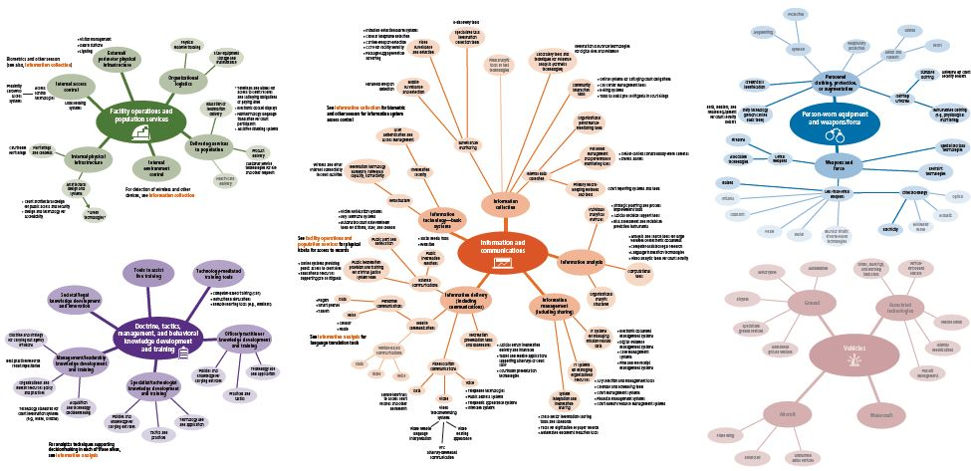
TECHNOLOGY AND TAXONOMY – COURTS

Slide 15
QUESTIONS?
Hon. Kirk Tabbey
tabbeyk@ewashtenaw.org

