Slide 1
Police Body-Worn Cameras (BWC): Practical, Policy, and Legal Implications
Dr. Michael White
Professor, Arizona State University
Co-Director, Training and Technical Assistance, BJA BWC Policy and Implementation Program (PIP)
Leadership Conference, National Association for Presiding Judges & Court Executive Officers
September 24-27, 2017, Scottsdale, AZ

Slide 2
Presentation Overview
The Backdrop: Why BWCs?
Primary Claims by Advocates and Critics
BWC Research: Four Key Findings
The BJA National BWC Toolkit & Other Resources

Slide 3
The Backdrop: Why BWCs?

Slide 4
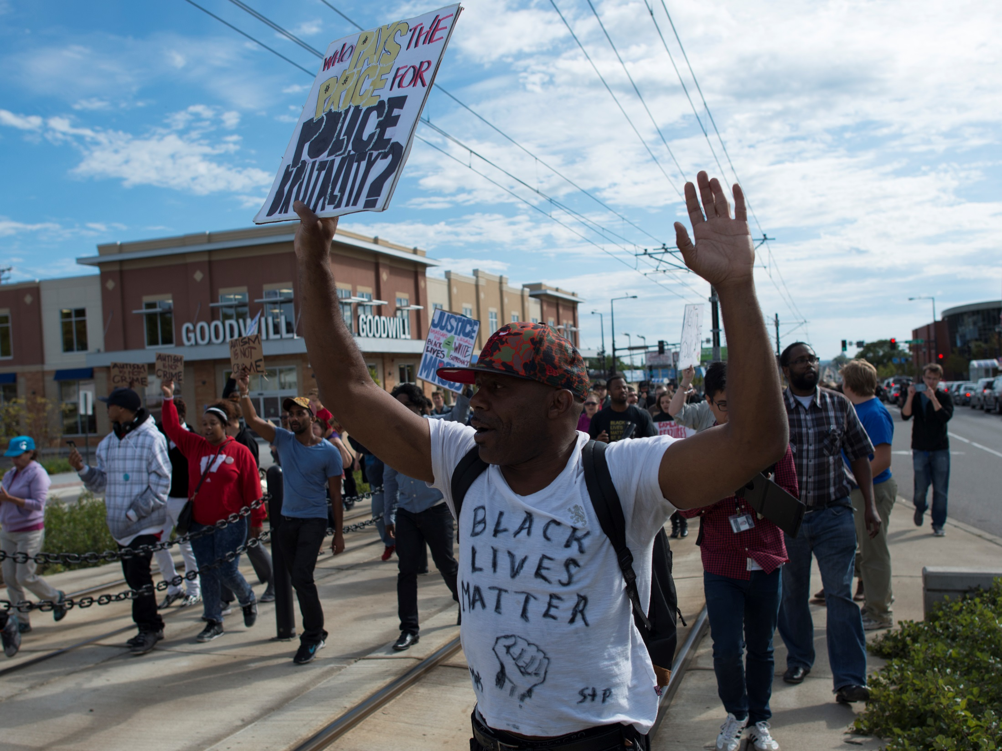

Slide 5
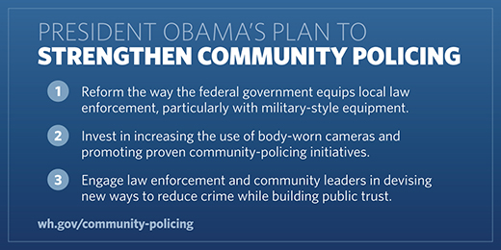
The Federal Push for BWCs
December 2014 – President Obama speech
-COP Plan
-President’s Task Force announced
-$75 million pledged for 50,000 BWCs
May 2015 – US DOJ releases the National Body-Worn Camera Toolkit
President’s Task Force on 21st Century Policing Final Report
September 2015 – 73 agencies awarded funding through US DOJ BWC Program ($19.3 million)
September 2016 – 106 agencies awarded funding through US DOJ BWC Program ($16.9 million)

Slide 6
Primary Claims by Advocates and Critics

Slide 7
Potential Benefits
Possible BWC Benefits are Enormous
Increased Transparency
Enhanced Legitimacy and Public Satisfaction
Improved Police Officer Behavior
Improved Citizen Behavior
Reduced Citizen Complaints and Police Use of Force
Expedited Resolution of Complaints and Lawsuits
Improved Evidence for Arrest and Prosecution
Opportunities for Police Training (violence reduction)

Slide 8
Concerns and Consequences
Possible Costs/Consequences are Enormous
Citizens’ Privacy
Officers’ Privacy
Officers’ Safety
Impact on Citizen Attitudes (Satisfaction/ Legitimacy)
Training and Policy Requirements
Impact on Officer Productivity/Morale
State and Federal Law (Public Records, HIPAA)
Logistical/Resource/Cost Requirements

Slide 9
BWC Research: Four Key Findings

Slide 10
Finding #1: High Levels of Police Officer Support

Slide 11
Finding #2A: High Levels of Citizen Support (general population)

Slide 12
Finding #2B: High Levels of Citizen Support (consumers of police services)
 | Spokane (249) | Tempe (383)
 | % Agree/ Strongly Agree | % Agree/ Strongly Agree
Video cameras should be worn by all officers in Spokane/Tempe PD. | 85.9% | 92.2%
Using video cameras will make officers act more professionally. | 76.6% | 79.3%
Citizens will be more cooperative when they become aware that an officer is wearing a video camera. | 70.2% | 76.2%
Police will be more respectful to citizens when wearing video cameras. | 78.9% | 79.6%
The benefits of police using video cameras outweigh the costs. | 77.0% | 82.5%

Slide 13
Finding #3: Consistent Reductions in Citizen Complaints and Use of Force (sometimes)
Rialto (CA) Police Department
Citizen complaints: 88% (24 to 3)
Use of force: 60% (61 to 25)
Mesa (AZ) Police Department
Citizen complaints: 60%
Use of force: 75%
Orlando (FL) Police Department
Citizen complaints: 60%
Use of force: 75%
Phoenix (AZ) Police Department
Complaints -- BWC officers: declined by 23%
Complaints -- Comparison officers: increased by 10.6%

Slide 14
Finding #4: BWCs Have Evidentiary Value
UK Studies
Guilty pleas 70-80%
Las Vegas Metropolitan Police Department
To date, 70% of BWC officers “exonerated” from complaints because of BWC evidence
Phoenix/Essex (UK) studies
Enhanced Outcomes in Domestic Violence cases. BWC cases:
Initiated by the prosecutor’s office
Charges filed
Guilty plea
Guilty verdict at trial

Slide 15
BWC POLICY AND RESEARCH RESOURCES

Slide 16
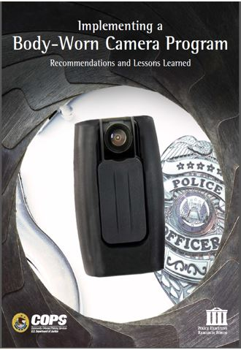
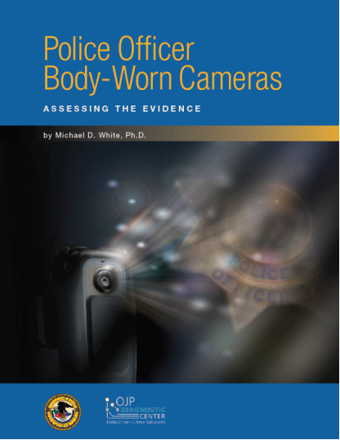
PERF/COPS and “Assessing the Evidence” Reports

Slide 17
BJA National Body-Worn Camera Toolkit: https://www.bja.gov/bwc/

Slide 18
Toolkit Podcast Series

Slide 20
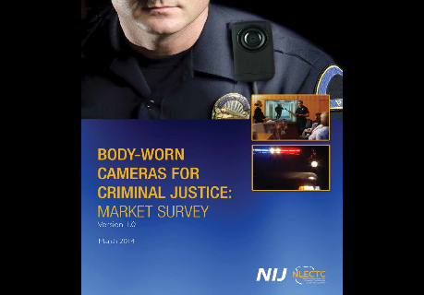
Other Policy-Related Resources
Model Policies: IACP, ACLU
George Mason report (Lum et al. 2015)
National Institute of Justice (NIJ) Market Survey

Slide 21
Thanks!
Michael D. White, Ph.D.
Professor, Arizona State University
Co-Director, Training and Technical Assistance, BJA BWC PIP
mdwhite1@asu.edu

