Slide 1
AZCourtHelp
Gary Krcmarik – Coconino County Court Administrator
Gretchen Hornberger – Coconino County Law Librarian
Amanda Weikal– AmeriCorps VISTA, AZCourtHelp Coordinator

Slide 2
What is AZCourtHelp?
Solution to the Access to Justice challenge
Statewide legal self-help program
Enhance on-site and virtual resources

Slide 3
Coconino County
Pilot for the whole state
Implemented into the Coconino Law Library self-help center
Why?
Start small and grow
Success with progressive programs
Available technology and resources

Slide 4
Contributors
Amanda Weikal - AmeriCorps VISTA, AZCourtHelp Coordinator
Gretchen Hornberger – Coconino County Law Librarian
Gary Krcmarik – Court Administrator for Coconino County Superior Court
Kathy Sekardi – Sr. Court Policy Analyst for Administrative Office of the Courts
Theresa Barrett – Court Programs Unit Manager for Administrative Office of the Courts
Debra Tanner – Section Chief Counsel for the Office of the Attorney General, Child Support Services
Yvette Asche-Liffick – Policy & Resource Administrator for AZ Dept. of Economic Security, Div. of Child Support Services
Janet Regner – Director of Coconino County Community Services
Kip Anderson – Court Administrator for Mohave County
Lori Linn – Mohave County Law Librarian
Arizona Foundation for Legal Services and Education – Website developers

Slide 5
Target Audience
Primary target audience:
People representing themselves in court
Anyone with a legal need
Secondary target audience:
Anyone assisting someone with a legal need

Slide 6
Program Overview
Website
Clearinghouse for statewide self-help resources online
Launch date in January 2017
Legal Talks
Series of educational legal workshops
Started in August 2016 in the Coconino County Law Library
Different Talks are presented on a weekly basis

Slide 7
Website
Partnering with the Arizona Foundation for Legal Services and Education
Website development
Website design
Ongoing maintenance
Started user testing in October
Coconino County Superior Court
Content
Links to each county’s self-help forms

Slide 9
Website
Legal Talks calendar
Shows upcoming Talks on homepage
Opportunity for participants to sign up
Legal glossary
Available in Spanish and other languages
Self-help forms from each county
Court details and virtual tours

Slide 10
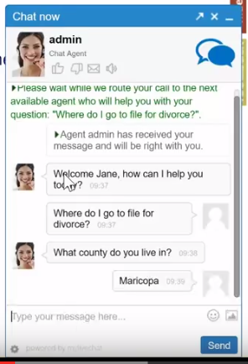
Website - Chat
Live chat reference service
Volunteer county law librarians
Including our own Coconino County Law Librarian
Each librarian has an assigned chat time
Digital help desk

Slide 11
Legal Talks
Legal workshops aimed at helping people represent themselves in court
Presented live at Coconino County Law Library
Available from home
Broadcast-receiving sites
Mohave County
Yavapai County

Slide 12
Legal Talks
What are the topics?
Family Court
Guardianship and Conservatorship
Arizona DUI Law
Immigration Law
Child Support Services
Landlord/Tenant Law
Co-parenting 101
Family Law jurisdiction in State vs. Tribal Court
General guidelines for a civil lawsuit

Slide 13
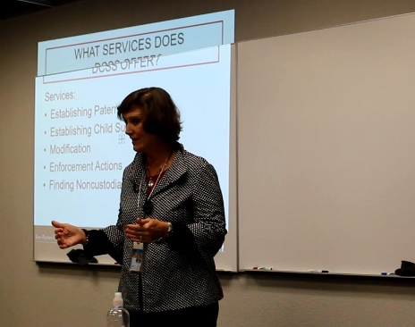
Legal Talks
Who are the presenters?
Volunteer professionals such as:
Private attorneys
Legal aid attorneys
Law librarian
Mediator
Attorney General’s Office
DES – Div. of Child Support Services

Slide 14
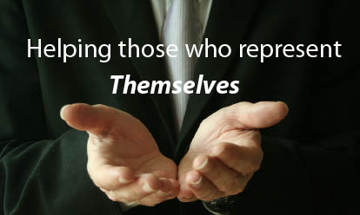
Legal Talks
Who’s in the audience?
People representing themselves in court
Representatives from social services
Court employees
Attorneys

Slide 15
Benefits
Legal Talks more open-ended
One-on-one interaction with an expert
Helpful for social/aural learners
Tailor to user needs and local talent
Use technology to bring info and local resources to more people

Slide 16
How You Can Help
Advertise
Broadcasting
Hub
Receiving-Site

Slide 17
Questions?

