Slide 1
CRIMINAL JUSTICE COORDINATING COUNCILS FROM SILO TO SYSTEM COORDINATION
A REAL LIFE EXAMPLE
by
Chief Judge Maxine Aldridge White
September 26, 2017

Slide 2
"Working collaboratively to ensure a fair, efficient, and effective justice system that enhances public safety and quality of life in our community."

Slide 3
Milwaukee, Wisconsin

Slide 4
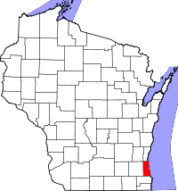
Milwaukee County
Population = 956,406
Land Area = 2,430 sq. miles
Median Household Income = $43,873
Jail Population = 2,430
Racial Makeup
White = 53%
Black = 27,2%
Hispanic = 14.2%
Image from Wikipedia
Data from 2014 US Census Bureau

Slide 5
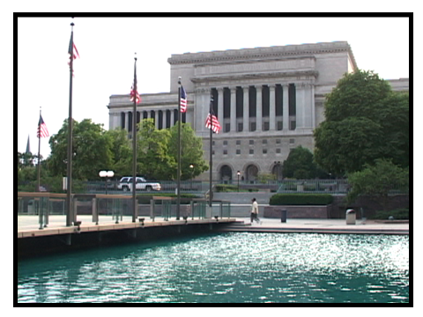

Slide 6
PREPARING TO LEAD THE COLLABORATIVE
Chief Judge of a court system inclusive of 47 state, courts plus 24 commissioners, 19 municipal courts funded by state, county & local with federal and private partners
Currently serving second (two-year) term of CJC Executive Committee Chair
Collaborative experience prior to CJC, includes:
Chair- statewide commissions and task forces
Judicial representative on WI Judicial Council
CORE partner with USDOJ/OVW, City, Family Peace Center and Children’s Hospital to open Safe Haven Center

Slide 7
Milwaukee Community Justice Council
Long-standing culture of collaboration in Milwaukee
Ad hoc, collaborative meetings were occurring prior to the formal creation of a council
Established May 17, 2007 by resolution of the Milwaukee County Board of Supervisors – a legislative body
Technical Assistance beginning in September 2006
One result from settlement negotiations in a long standing lawsuit over conditions and crowding at the jail
Initial purpose-to serve as a convening body of local Executives to ensure communication, coordination and collaboration for criminal justice system improvement

Slide 8
Creation of the MCJC
Continuity of Leadership in key stakeholder positions
Partnerships
Public Policy Forum
National Institute of Corrections
JEHT Foundation
Funding and technical support
Development of Rules, Process and By-laws
Establishment of organizational components
Focus on Community

Slide 9
Same folks, expanded mission
"Working collaboratively to ensure a fair, efficient, and effective justice system that enhances public safety and quality of life in our community.“
Revisiting Purpose
"to function as an independent entity governed by key justice system leaders that is empowered to define broad justice system goals, monitor/analyze justice system performance, facilitate collaboration among justice system partners, provide technical assistance and research, and act as a conduit between the justice system and the larger community without impacting in any way the autonomy or decision-making authority of any criminal justice system agency" - Adopted by the Justice Council Executive Committee on March 19, 2014.

Slide 10
MCJC Executive Leadership

Slide 11
MCJC Structure
Full Council - 26-independent agencies; inclusive of government and non-profit organizations
Governance -18-member Executive Committee of local, state and federal elected and appointed leaders and a community representative
Executive Committee strong oversight - empanels subcommittees and ad hoc groups tasked to identify trends, offer recommendations and make suggestions of priority areas for change
Staffed with a paid, full-time director and SJC project manager and in-kind designees from participating executives

Slide 13
Judiciary’s Role in MCJC
Judiciary - played a vital role in the creation and momentum in our MCJC
Leadership – the Chief Judge has served as the Executive Committee Chair for over half of the MCJC’s 10-year existence
Meeting facilitator
Main point of contact
Convener of local government leaders
Cheerleader/Multiplier - ensures positive working collaborations
Brings big picture optics

Slide 14
Executive Specific Roles
Executives - at the helm, leading by example, including DA, SPD, Sheriff, Local law enforcement, Mayor, County Executive, County Board, USDOJ attorneys and agents, US Marshall, DOC, Behavioral Health, etc.
Executives can designates and provide staff support, including:
Leadership on committees
Teaching/participating
Adopt and implement certain policies
Data Use Agreement
Assist in design and Utilize Pretrial Risk Assessment
Support Specialty courts, Treatment Courts, Dosage Probation

Slide 15
Success = Challenges
Convening authority is POWERFUL!
Combining Community, Justice and Public Health concepts
Creating safe space to have serious discussions about matters over which we will seriously disagree
Supporting therapeutic justice models, e.g. drug treatment court, front end interventions, diversion, universal screening, trauma training
$2 Million MacArthur Foundation Grant supporting 6 strategies across justice stakeholder lines
Expanded discussion on racial and ethnic disparities within the criminal justice system
Authentic community engagement allowing the community at monthly meeting to engage with top executives
Innovation and improved data exchange

